Slide 1
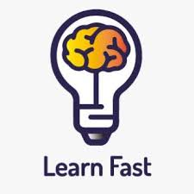
Challenge 0
Topic 2: Learning how to learn and learn fast.
Name: Tran Trung Hieu

Slide 2
Table of contents
02
03
04
05
01
What is learning and fast learning?
How to learn and learn fast?
Why learn how to learn?
How do I learn a new knowledge.
Conclusion

Slide 3

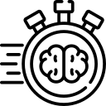
01. What is learning and fast learning?
Learning: A journey of growth
Learning is the process of acquiring new knowledge, skills or understanding. It’s the way we expand our horizons, capabilities and make sense of the world around us.
Fast learning
Fast learning is the process of acquiring new knowledge and problem-solving skills with an emphasis on time management. It includes:
- Acquiring knowledge quickly.
- Deep understanding.
- Adaptability and agility.

Slide 4
02. Why learn how to learn?
Unlocks Continuous Learning:
- Lifelong learner - Independence and autonomy
Boosts Efficiency and Effectiveness:
- Master complex subjects - Master complex subjects
Enhances Personal Growth:
- Develop a growth mindset
- Increases confidence and self-efficacy
Beyond Personal Impact:
- Improves problem-solving skills
- Contributes to society

Slide 5
03. How to learn and learn fast
Set clear goals
Clearly understanding the problem
Have effective strategy
Time management
Apply technology

Slide 6
04. How do I learn a new knowledge.
Learn general knowledge

Slide 7
05. Conclusion
Learning is a way to acquire new knowledge.
Learning fast is a good way but we need to have a good strategy.
Learning fast is a way to gain new knowledge effectively and save time and effort.

Slide 8
Thank you very much

